Slide 1

Introduction to Unifrog for Parents and Guardians

Slide 2

What is Unifrog?
Unifrog believe that destinations - where students end up after school - is even more important than their academic performance. They partner with schools to support students to progress into the best opportunity for them.
Unifrog do this by providing a one-stop-shop where students can explore their interests, then find and successfully apply for their best next-step after school.
We use unifrog in school for careers, university and apprenticeship research as well as logging work experience placements and finding special opportunities to extend learning.

Slide 3
The Unifrog tools
Access all tools on Unifrog to learn what options are available, access good quality information, and search for opportunities to support your child.
Recording what you’ve done
Searching for opportunities
Drafting application materials
Making applications
Quizzes
Exploring pathways
Interests profile
Careers library
Activities
UK universities
UK Personal Statement
Post 18 Intentions
Personality profile
Subjects library
Skills
US universities
Classes
Locker
Work environments profile
Know-how library
Interactions
European universities
Subject References
Applications list
MOOC
Oxbridge
CV / Resumé
Skills profile
Webinars
Canadian universities
Writing tool
Read, Watch, Listen
Asian universities
Common App Essay
Australasian universities
US recommenders
MidEast and Africa unis
Notes for Reference writers
Irish universities
Special Opportunities
Events

Slide 4

Careers library
Over 1000 career profiles
Presents information from a range of sources, including local and national LMI
Includes qualifications and skills needed, interviews with industry professionals and labour market information
Explores progression opportunities and what a working week really looks like

Slide 5

UK Universities
Students can enter subject of interest and projected grades to see all relevant university courses available in the UK
Rank and filter opportunities by factors like hours of lectures, price of accommodation and graduate job rates
Get direct links to university information pages, with impartial information on courses and institutions
Save unlimited shortlists to refer back to later

Slide 6
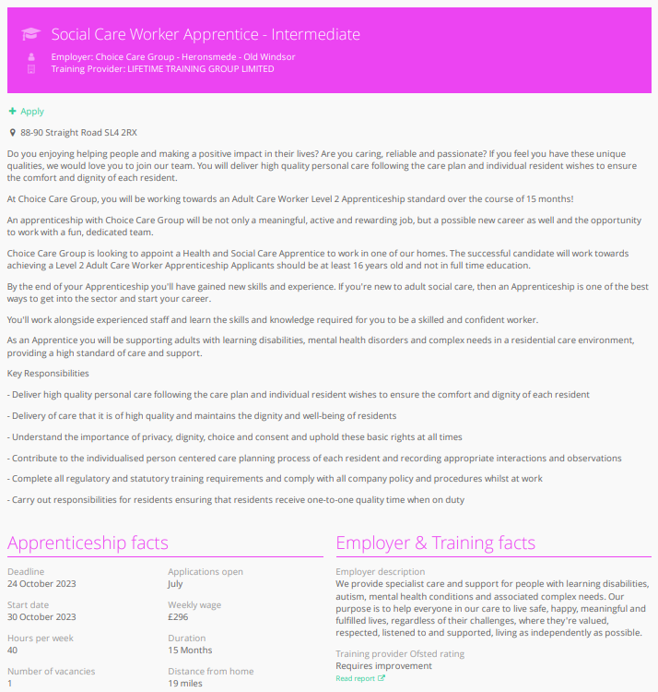
Apprenticeships
Students can find live apprenticeship vacancies
Vacancies are updated daily
Rank and filter opportunities by factors like distance from home, weekly wage and application deadlines
Direct link to the ‘apply’ page
Each apprenticeship vacancy includes practical information about the opportunity, employer and training
Students can enter the Unifrog Talent Pool to put their name out there for Unifrog employers to contact them on
Save unlimited shortlists to refer back to later

Slide 7
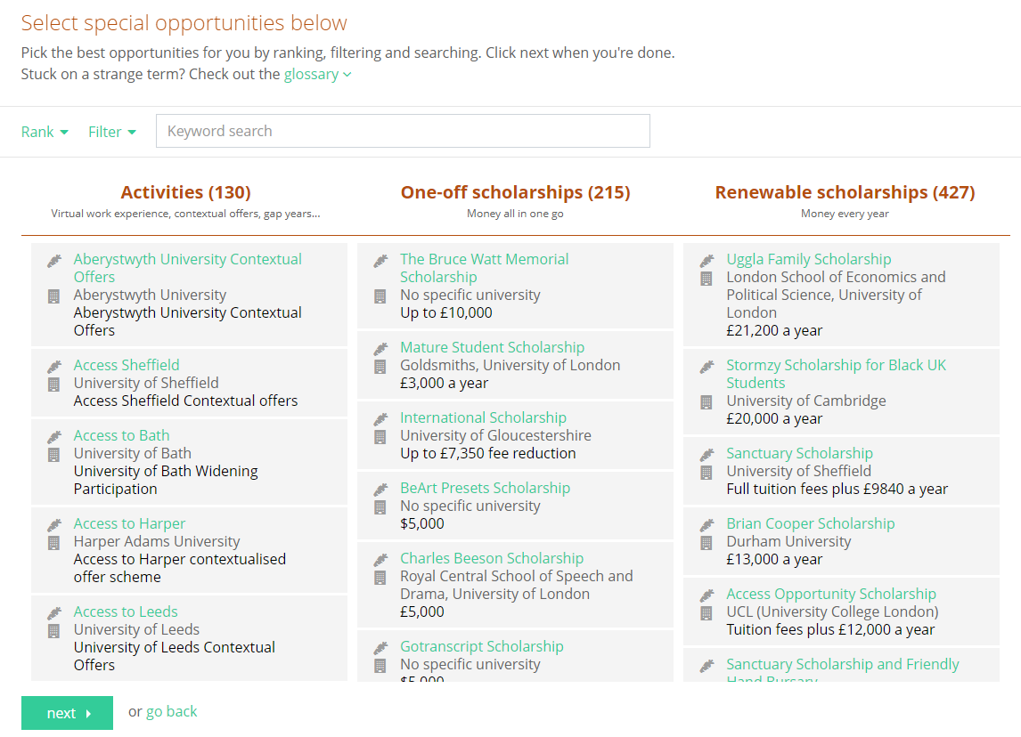
Special Opportunities
Includes £5 million-worth of grants, bursaries, scholarships, contextual offers and extracurricular activities
These can be filtered by circumstances or characteristics, depending on the access requirements of the opportunity
Includes direct links for applying
Unlimited shortlists can be created and referred back to

Slide 8
Placement Tool
We are going to be using Unifrog to look for potential placements as well as recording where the placement is going to be.
This sends a request to placement providers to fill out a form for safeguarding the students whilst they are on work experience placements.
We need this form to be completed by both the student as well as the placement provider for the work experience to go ahead.

Slide 9
Using Unifrog at home
We would encourage you to spend some time with your child at home looking with them at the unifrog tool.
If you ask them to log-in you will be able to see all the resources and libraries they have access to as well has help them with making short-lists.
This can be quite a useful starting point for organising open days as well as looking for placements.
If you would like a Unifrog account yourself to link to your child’s account, please let Mrs Bacon-Clarke know.

Slide 10
GDPR
GDPR is a regulation in EU law on data protection and privacy for everyone within the European Union and the European Economic Area.
Unifrog takes data security very seriously, and as such, has several features in place to protect school and student data.
We only use EU data centres, have multiple firewalls, layered-access security and more. Information on this can be found at unifrog.org/about#security
Notes:
Unifrog’s privacy policy can be found here: https://www.unifrog.org/privacy-policy
Service terms can be found here: https://www.unifrog.org/website-terms

