Slide 1
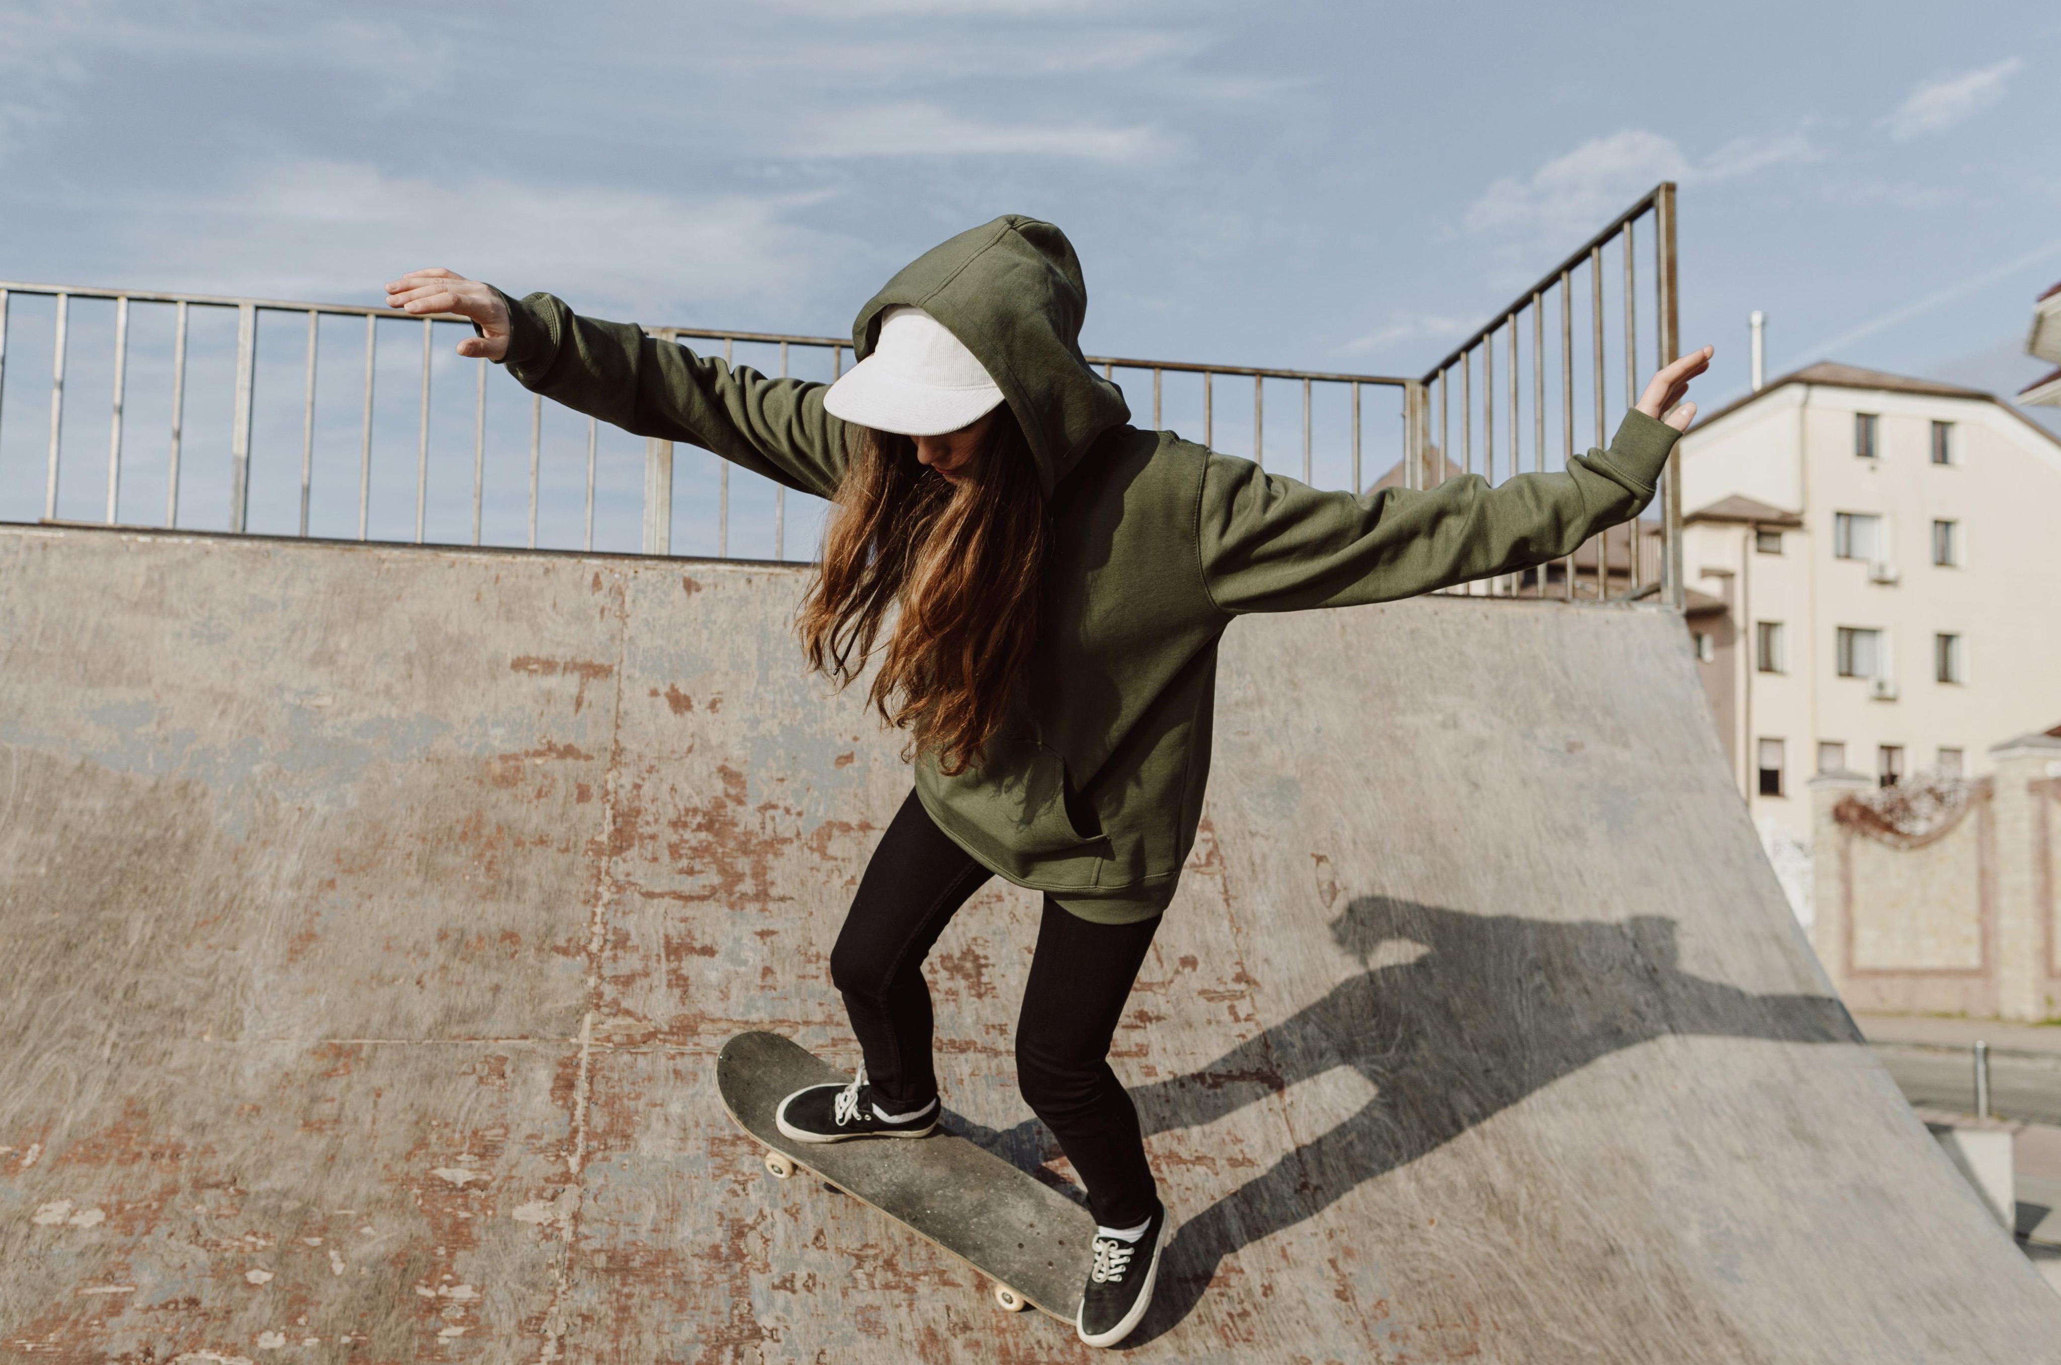




Slide 2
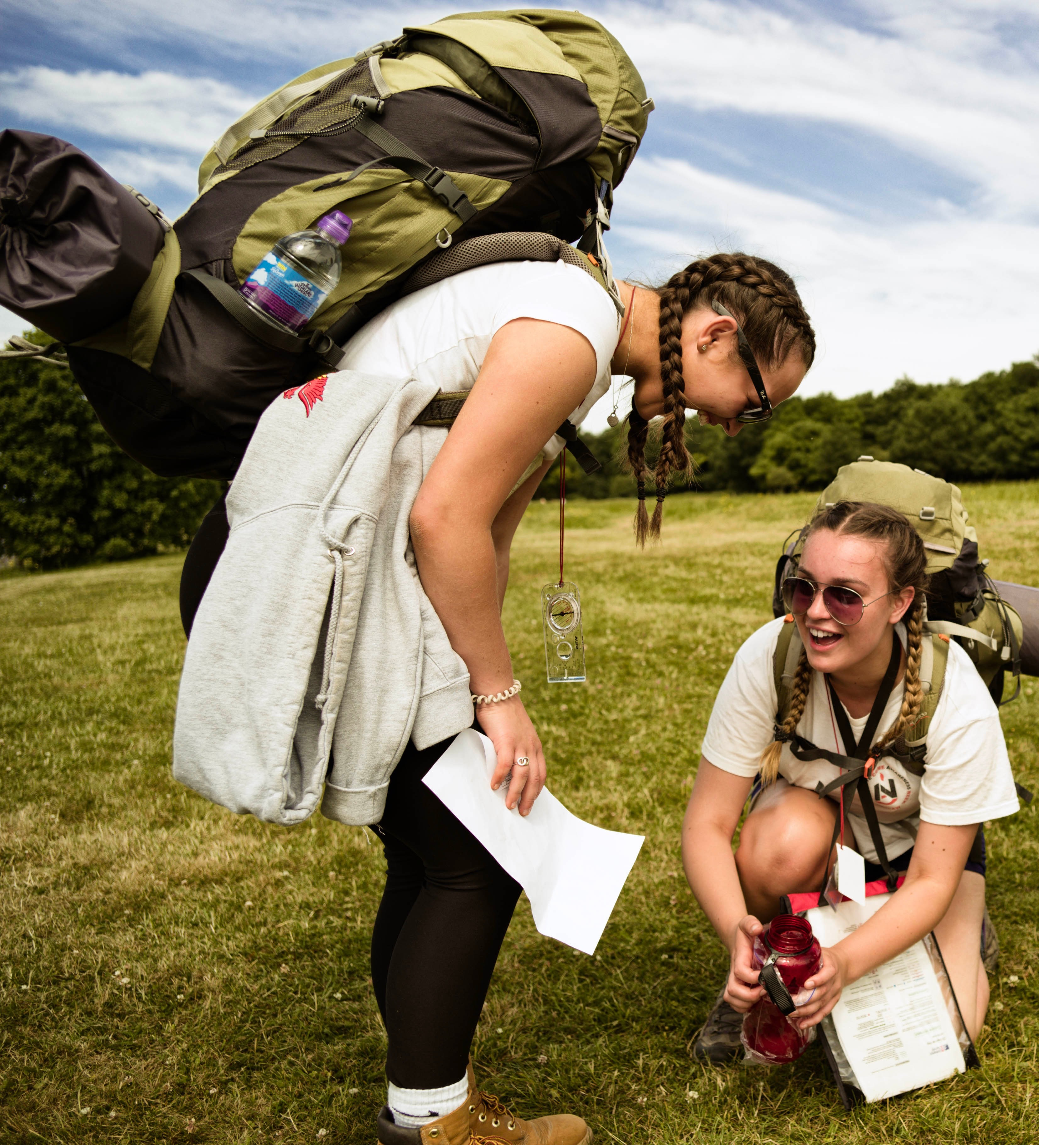

What is the DofE?
The DofE is a life-changing adventure.
You make it: The DofE is as unique as you are
Millions of young people in the UK have already done their DofE.
Now it’s your turn.
Notes:
The DofE is a life-changing adventure which will help you develop the skills you need for your future life and work. ​
The DofE gives you the chance to discover just how much you’re capable of.
It’s a great way to try new things, do what you love and make a difference in your community.

Slide 3
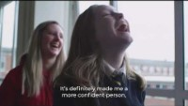
Introducing the DofE
Notes:
The following film provides an overview of the Duke of Edinburgh's Award.

Slide 4
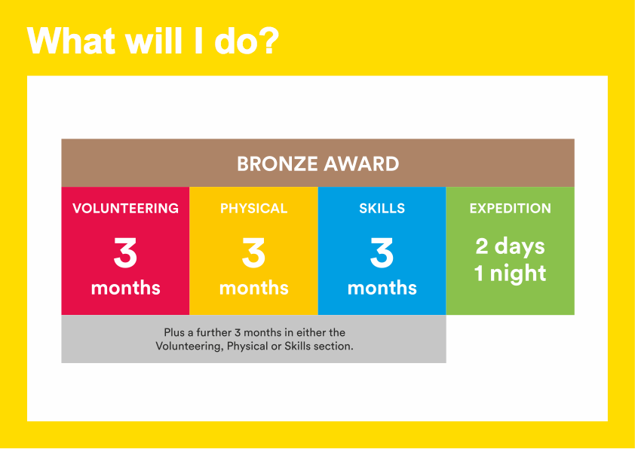
Notes:
To achieve your DofE Bronze Award, you will need to complete four sections – Volunteering, Physical activity, developing a skill and the Expedition.​
Activities for each section take a minimum of one hour a week, so they can easily fit in around your studies and other interests.​
You will need to spend at least 3 months completing each of the Volunteering, Physical and Skills sections.
You will also need to decide which one of these you would like to do for six months.​
You will need to keep a record of the time you spend on each activity.
You should ask somebody who has a good understanding of the activity you have chosen to write a report describing what you have done (but this cannot be a family member).​
It may seem daunting at first but remember that most activities can count towards your DofE.

Slide 5

Volunteering section
Take action and make a difference to the causes you care about
Help others and change things for the better
Notes:
As part of your Bronze DofE Award, you will need to donate some of your time to volunteering.​
Volunteering is a chance to help other people, and to make a difference to the causes you feel most passionate about.​
As well as changing things for the better, lots of young people find that volunteering is a great way to increase their confidence and gain new skills.​
Examples of volunteering could be coaching a local football team, collecting items for a foodbank or campaigning for change on issues you feel passionate about
You can choose to volunteer in any area you would like – the only rule is that you must not be doing a job that companies would normally pay somebody for.​

Slide 6
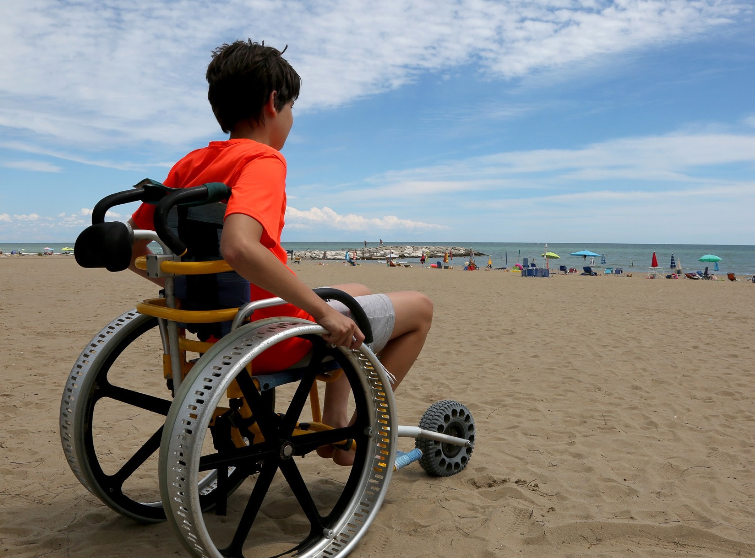

Physical section
Take part in whatever
dance, sport or ﬁtness
activity you would like
Get ﬁtter and have fun
along the way!
Notes:
To complete the Physical section of your Bronze Award, you will have the opportunity to take part in regular physical activity.
Becoming more active can be a huge amount of fun, and it can also help you feel happier and healthier.
Almost any dance, sport or fitness activity can count — it’s completely up to you which activities you choose.
You may decide to join a team or to do something on your own.
You may like to try something completely different, or to concentrate and improve on an activity you already do.
​

Slide 7
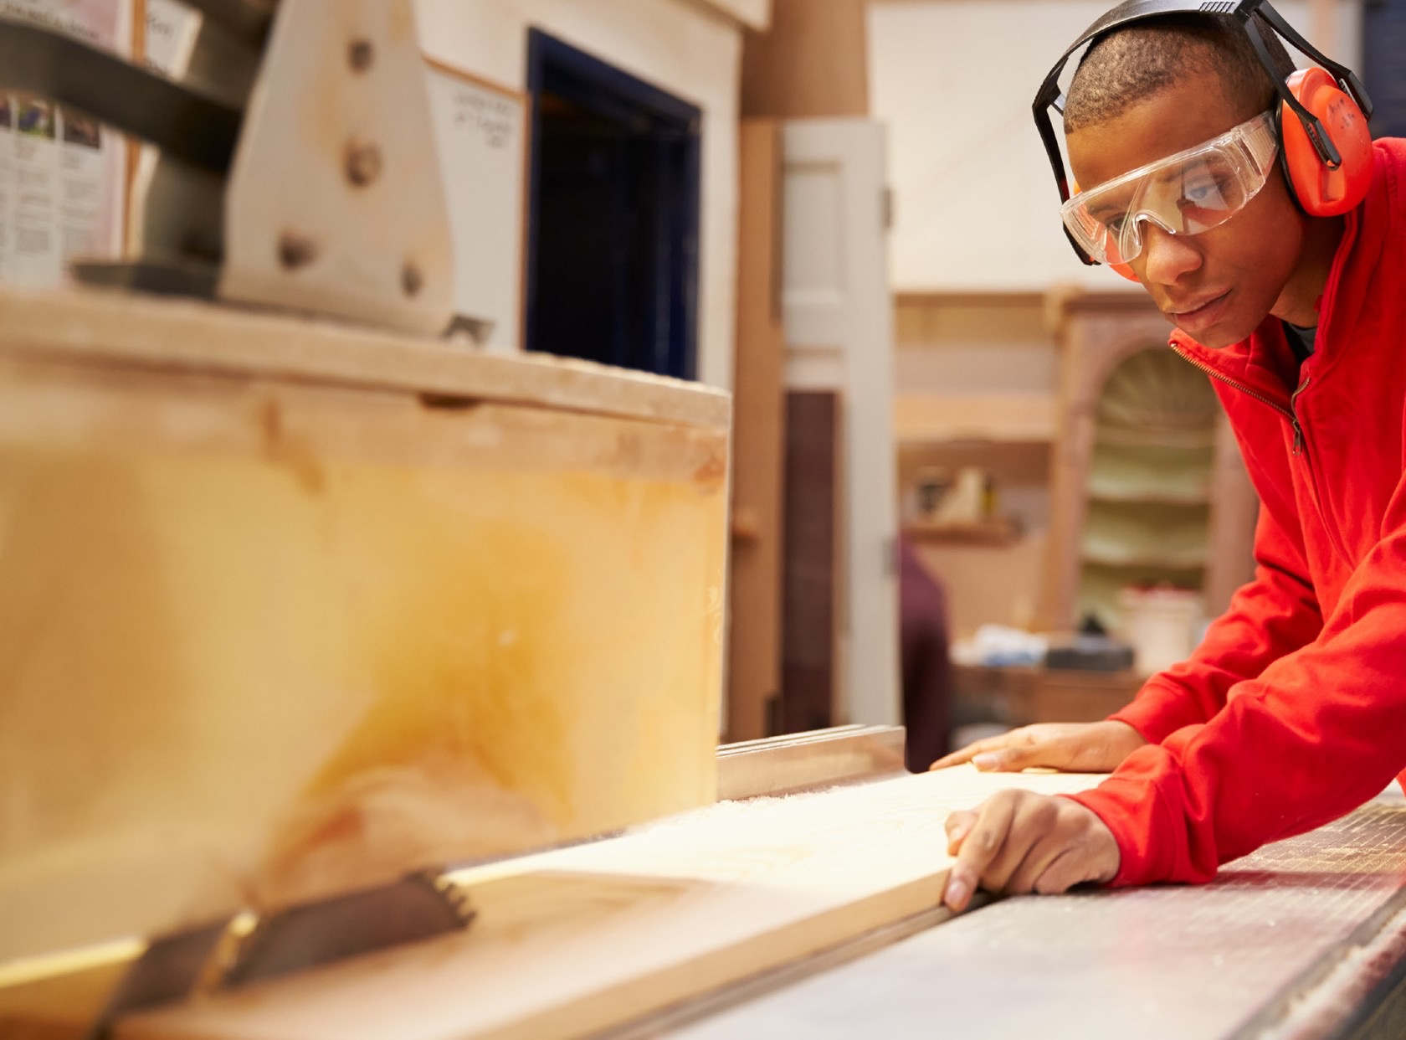
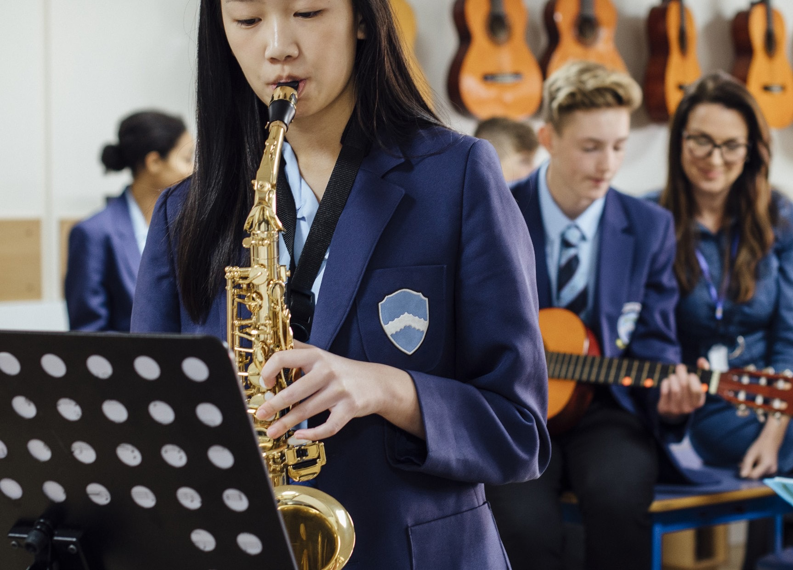
Skills section
Devote yourself to improving your skills in the things you love to do
Discover new passions and develop talents you didn’t know you had
Notes:
Through the Skills section, you will be encouraged to develop your practical and social skills in an area you can choose.
You can decide whether you will try to get better at something you already feel passionate about, or learn to do something new.
In the past, young people have done a huge range of different activities for their skills section, such as computer coding, driving and cooking.
Gaining new interests and talents is a huge amount of fun and lots of young people also feel a real sense of achievement from doing it.
​

Slide 8
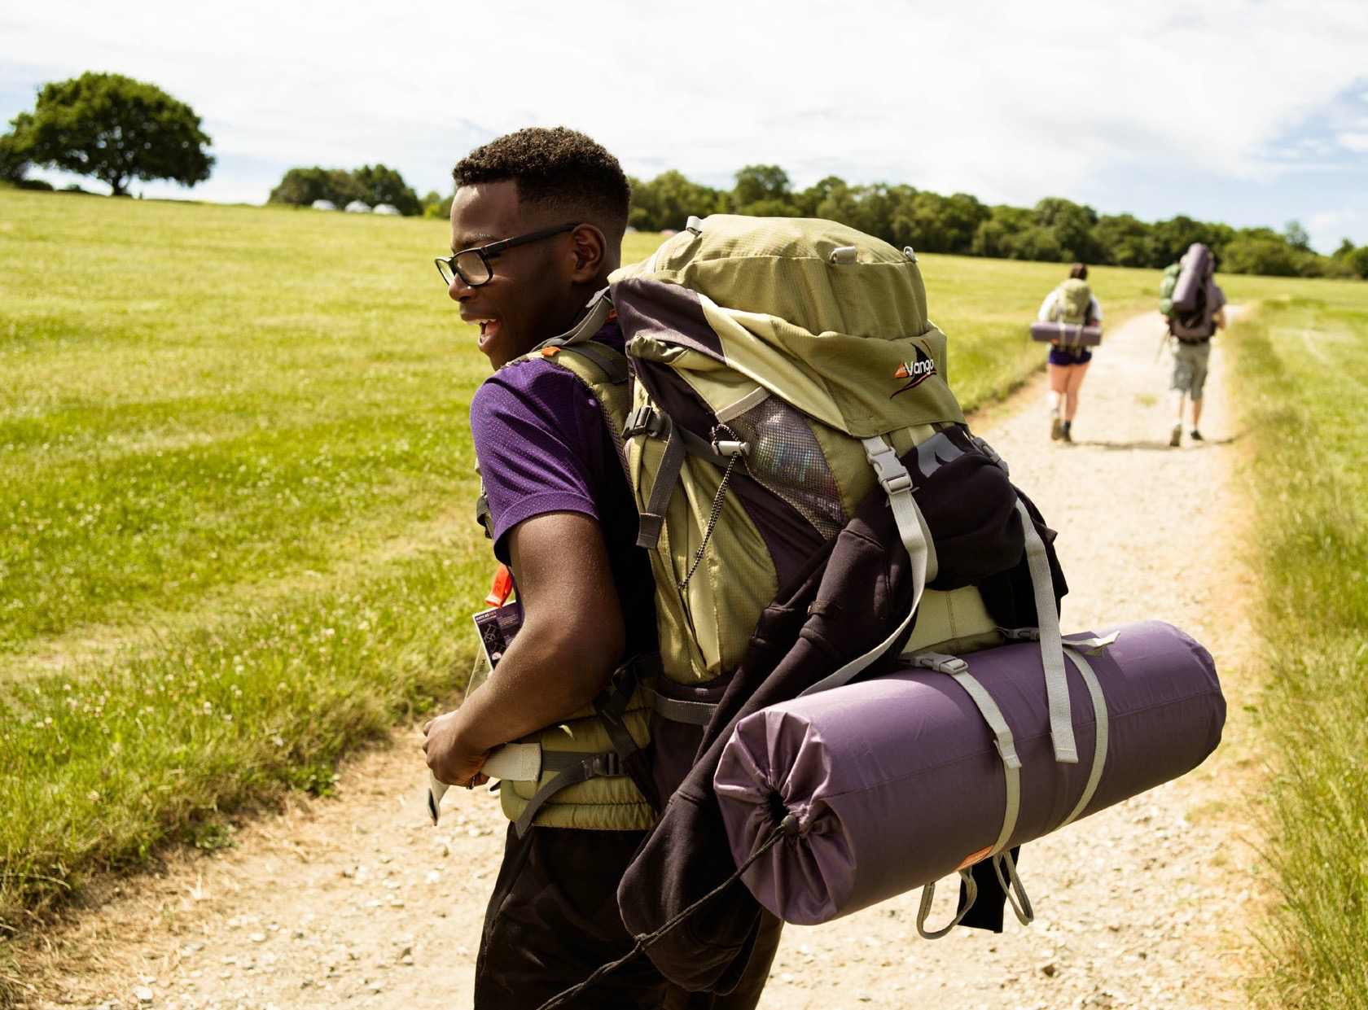

Expedition
Explore the great outdoors and spend a night away from home
Create memories that will last a lifetime
Notes:
The final section of your Bronze DofE Award is the Expedition.​
​As part of a small team, you’ll plan your aim, choose your route and do some training to make sure you’re prepared and know what you’re doing — then spend two days and one night away.​
​Your Expedition will improve your resilience, communication, teamwork and leadership skills. ​
You will need to have completed both 3-month sections and started the 6-month section before you are enrolled on to the expedition
​

Slide 9


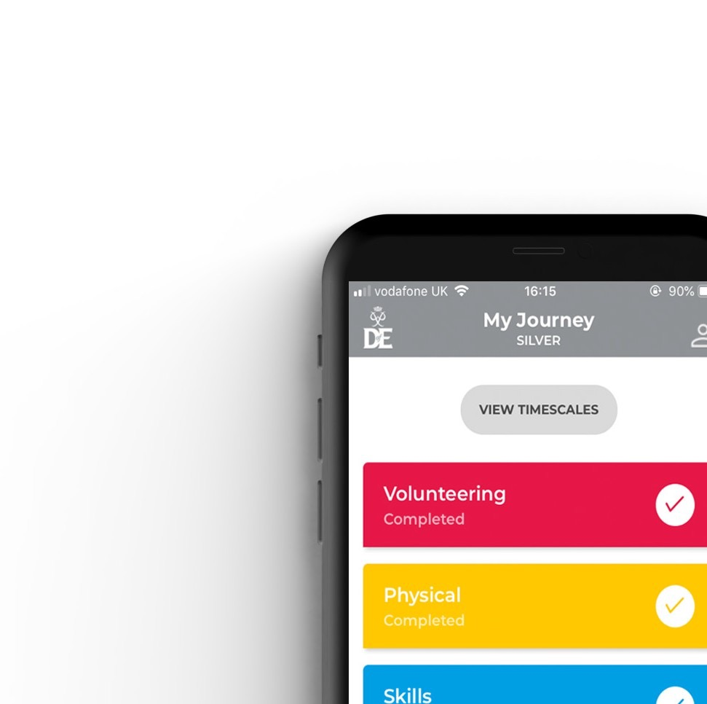


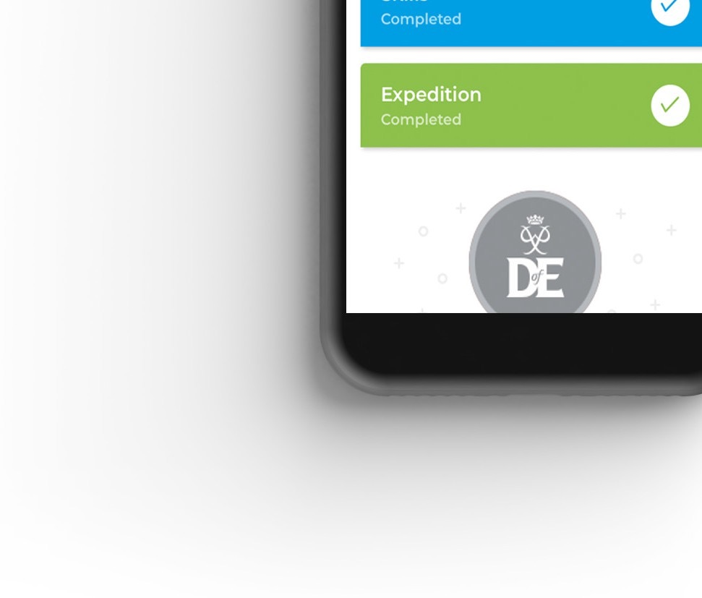
Your Welcome Pack and eDofE
Notes:
Once you have signed up to do your DofE, you will receive a Welcome Pack in the post which contains lots of useful information and advice. ​
​You will also get your own eDofE account so that you can plan your activities online using the free DofE app.​
​You will also receive a DofE Card which will give you and your family money off in several shops selling the sorts of equipment you may need.​

Slide 10
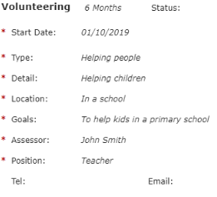
Starting volunteering / physical / skills
For each activity you need to decide
what you want to do,
how long you will do it for,
what you hope to achieve,
who will assess you.
You enter these details into eDofE and submit the programme planner for your leader to approve.
Notes:
The assessor cannot be a member of your family.

Slide 11
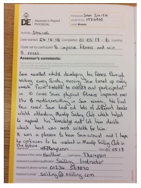
Signing off each section
At the end of the expedition, you will get an individual report.
For the other three sections, your assessor will write a report that gets uploaded to eDofE.
Notes:
The report must be written by your assessor, and must include the duration and frequency of the activity, as well as a comment on progress made and skills gained.

Slide 12


Completing the award
Once all four sections are complete, your leader will approve the award.
Once this is verified, you will get a badge and certificate, and can call yourself a Bronze Award Holder.

Slide 13
Key dates
Saturday 13th September – initial training day at Arnold Hill
Sunday 14th September – a training walk in Nottinghamshire
Friday 26th to Saturday 27th September – a two day, one night, expedition in Derbyshire
Notes:
Students will need to attend both training days to be eligible to go out on the final expedition.
Transport to / from Derbyshire is not included, so parents will need to make arrangements for this.
Students need to successfully complete the final expedition in order to sign off this section on eDofE
There is no flexibility on these dates

Slide 14
Equipment
Wayahead will provide all of the team equipment; this includes tents, cooking stoves, first aid kits, compasses and maps.
Students will need to provide personal equipment; this includes rucksacks, sleeping bags, waterproofs, boots and personal equipment.
We have a small stock of personal equipment that can be lent out.
A more detailed kit list will be sent out later.
Notes:
Rather than buying everything from new, talk to friends / relatives / neighbours to see what can be borrowed.
If buying new boots, then make sure that these are worn in properly prior to the training days.

Slide 15
Getting started
Attend the student meeting after February half-term.
Complete the consent forms, and pay the initial deposit, by Monday 24th February.

